Slide 1
Extreme Programming (XP) Model
Revolutionizing Software Development with Collaboration and Flexibility

Slide 2
What is Extreme Programming (XP)?
- XP is an Agile methodology emphasizing customer satisfaction, feedback, and adaptability.
- Focus Areas:
• High-quality software
• Rapid iterations
• Close collaboration

Slide 3
Key Principles of XP
1. Simplicity – Keep designs and solutions simple.
2. Feedback – Continuous feedback from team and customers.
3. Courage – Adapt to changes confidently.
4. Respect – Team collaboration and mutual respect.
5. Communication – Constant communication among team members and stakeholders.

Slide 4
XP Practices
- Planning Game: Short, frequent planning sessions.
- Small Releases: Frequent delivery of working software.
- Test-Driven Development (TDD): Writing tests before code.
- Pair Programming: Two developers working together.
- Continuous Integration: Frequent code integration to avoid big merges.

Slide 5
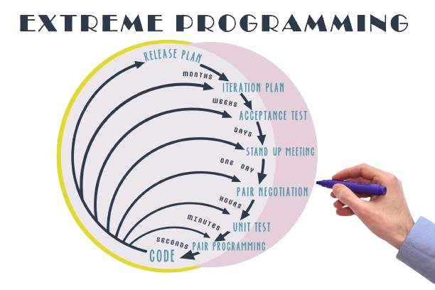
XP Lifecycle
1. Planning
2. Designing
3. Coding
4. Testing
5. Releasing

Slide 6
Benefits of XP
- Faster delivery of working software.
- High adaptability to customer needs.
- Improved team collaboration.
- Reduced development risks.
- Continuous improvement through feedback.

Slide 7
Challenges of XP
- Requires high customer involvement.
- Pair programming may be resource-intensive.
- Not suitable for all project types.
- Steep learning curve for new teams.

Slide 8
Is XP Right for Your Team?
**Ideal for:**
- Small to medium-sized teams.
- Projects with changing requirements.
- Environments where customer collaboration is strong.
**Not Ideal for:**
- Large, rigid projects.
- Teams resistant to Agile practices.

Slide 9
Real-Life Applications
- Companies using XP successfully (e.g., ThoughtWorks, Spotify).
- Case study example (e.g., improved delivery timelines).

Slide 10
Wrap-Up
- XP promotes agility, teamwork, and quality.
- Focus on simplicity, feedback, and continuous improvement.
- Suitable for teams embracing change and collaboration.
Call-to-Action: Is your team ready to go *extreme* with XP?

